Slide 1
Linear Algebra for Data Science
By
Dinesh Kumar Subramanian
Founder, Dteam

Slide 2
Agenda
Vectors
Vector addition, Scalar Multiplication
Linear Combinations
Matrices
Matrix vector Multiplication
Linear Transformations
Determinants
Inverse of matrix
Dot product and its Duality
Cross product
Change of Basis
Eigen values and Eigen vectors
Singular value decomposition

Slide 3
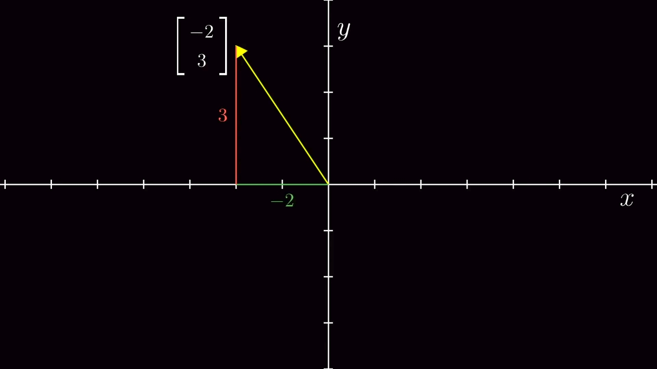
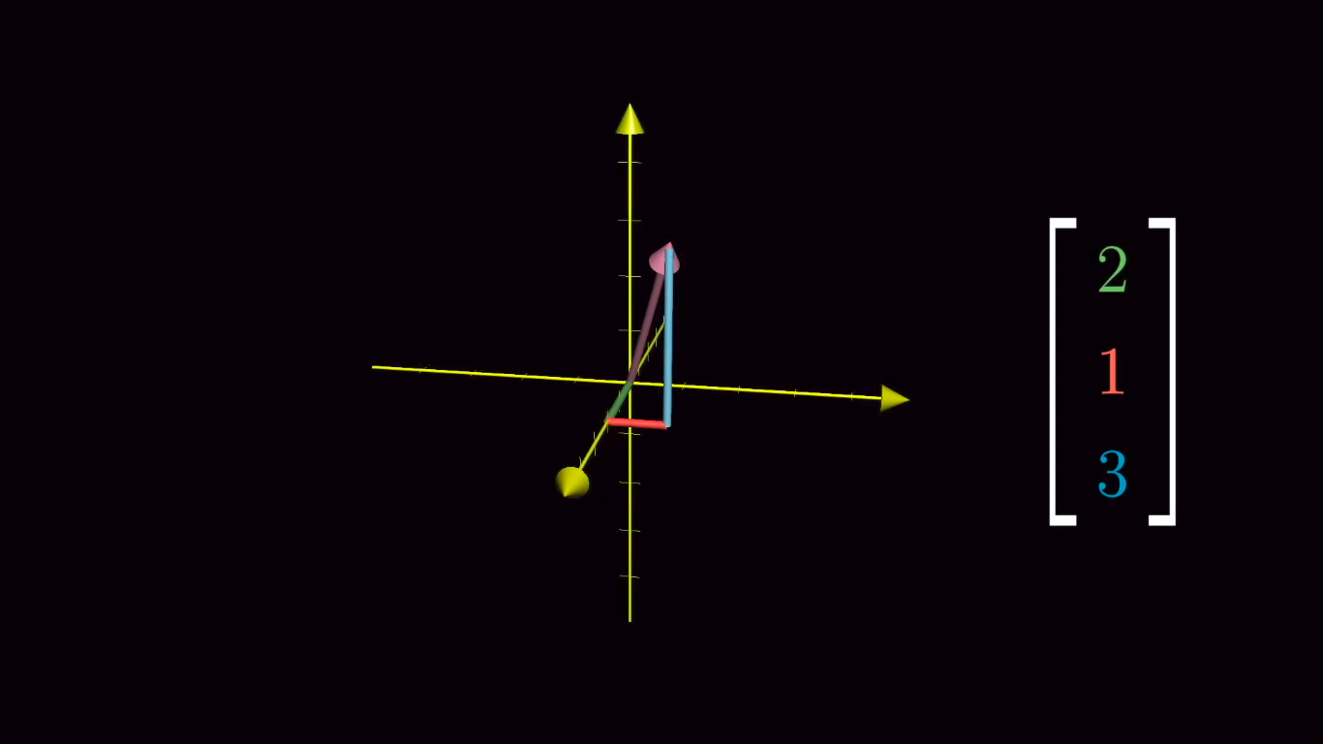
What is a Vector?
An Arrow inside a coordinate system with the tip sitting on the origin.
Vector can be of any dimension like 2D, or 3D upto n.
Coordinates of a 2D vector is a pair of numbers that tells,
1st no: How far to walk in X-axis
+ve - Rightward Direction
-ve - Leftward Direction
2nd no: How far to walk in Y-axis
If it is a 3D vector, 3rd no tells how far to walk on Z-axis.

Slide 4
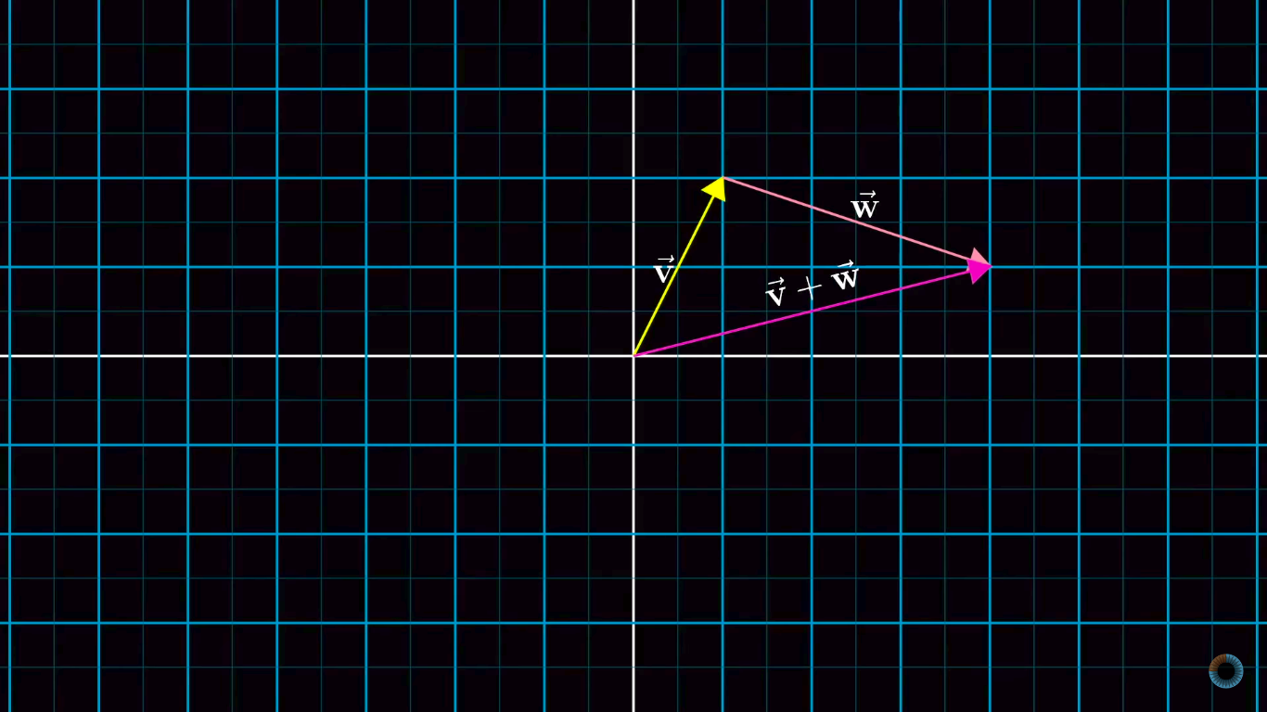
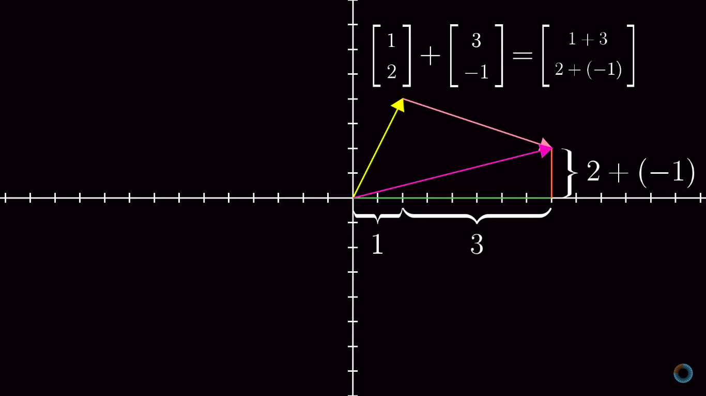
Vector Addition, Scalar Multiplication
The whole of Linear Algebra revolves around this.

Slide 5
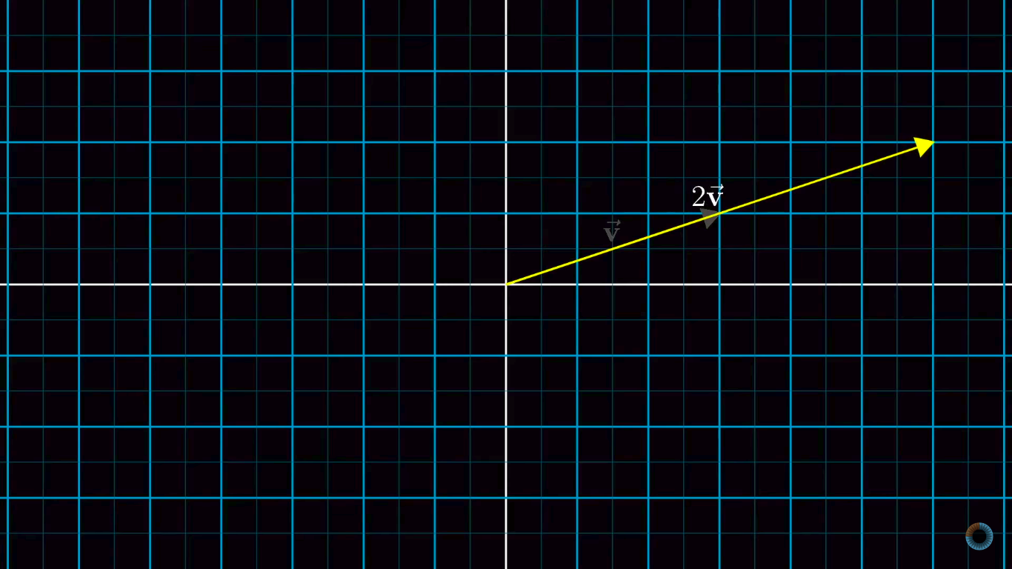
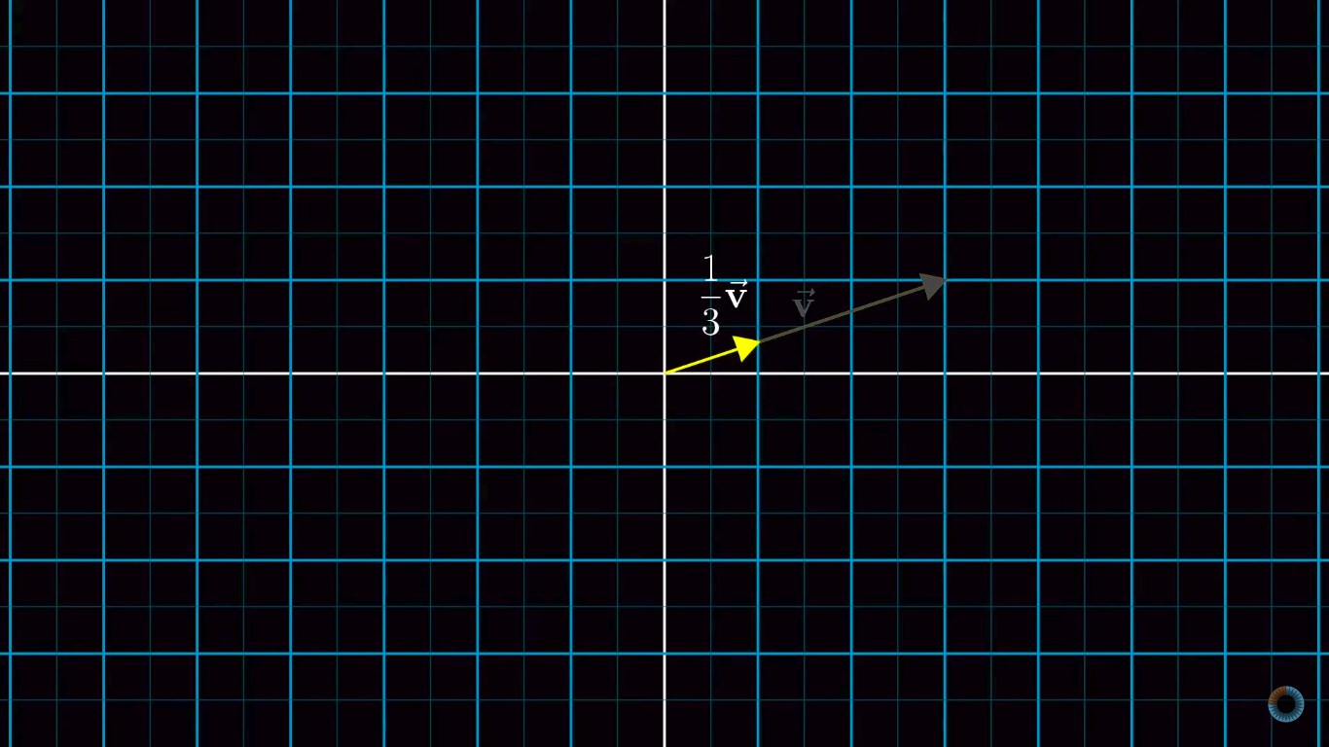
Vector Addition, Scalar Multiplication
What does happen when a Vector is multiplied by a scalar?
It stretches a vector’s magnitude
Or Squishes it.
The Word “Scalar” came from this operation of scaling a vector on its size.

Slide 6
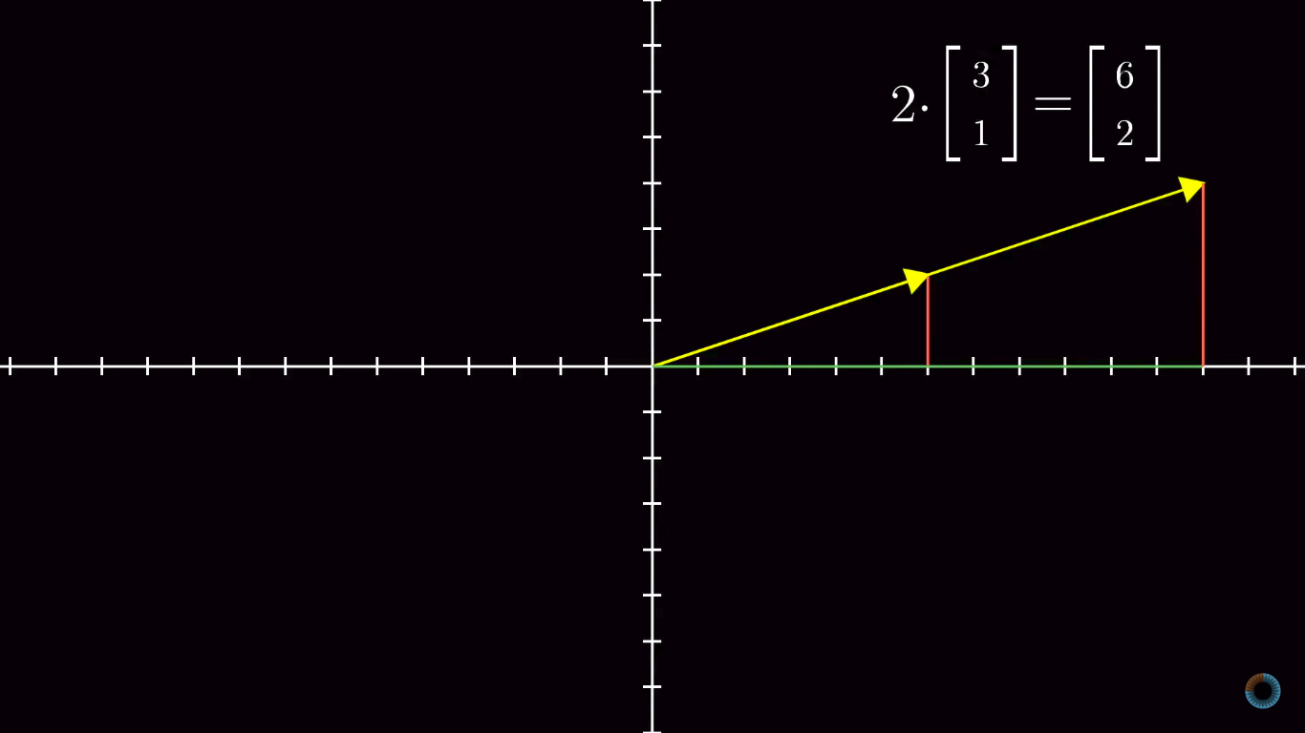
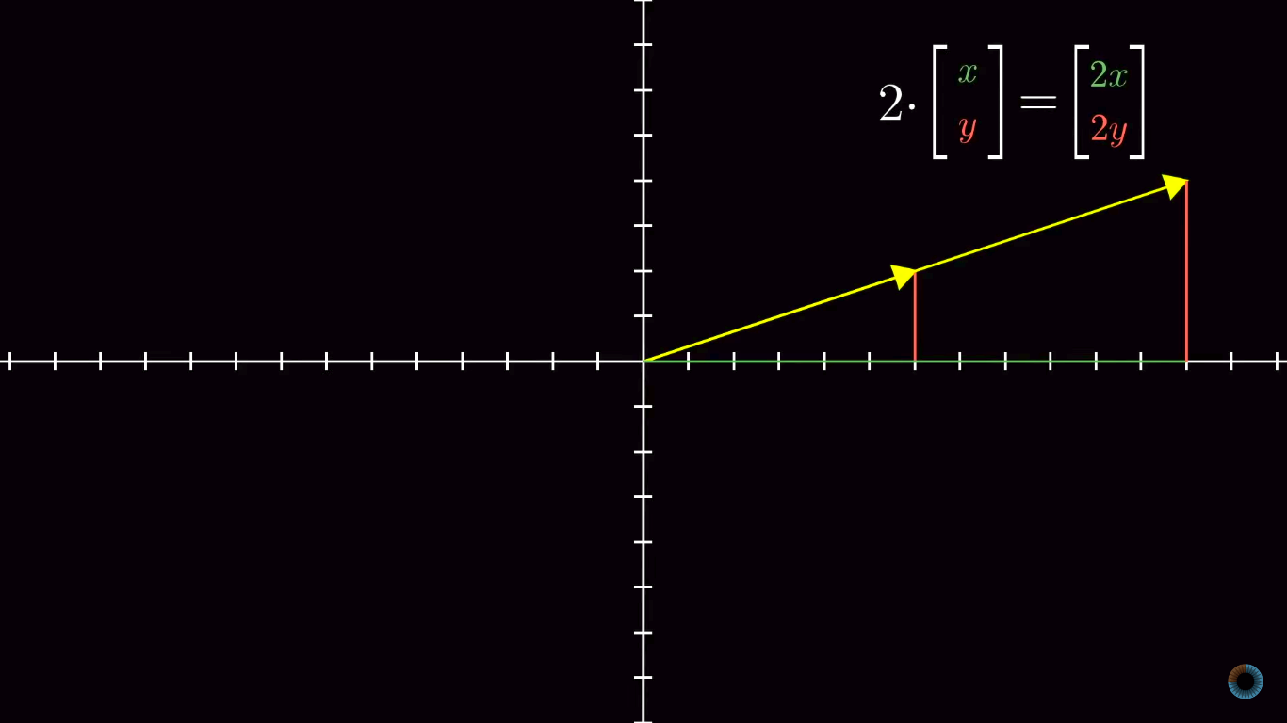
Vector Addition, Scalar Multiplication
But where does the scaled vector lands after scaling it with a scalar?

Slide 7
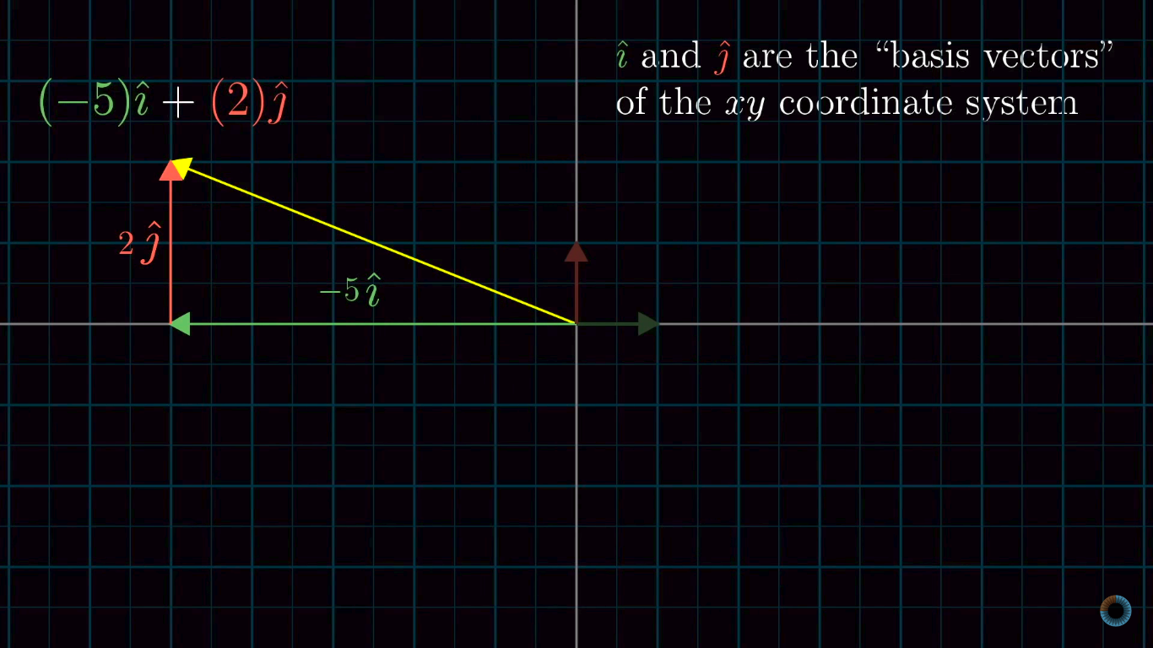
Linear Combinations, Span, Basis vector
Basis Vector is a set of Linearly independent vectors that span the full space.
Can we choose a different basis vector?
Yes.
A vector can be taken as scalar that stretches or squishes i and j.

Slide 8
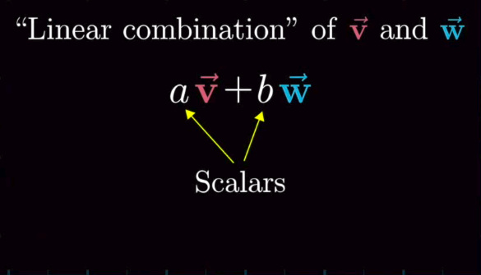
Linear Combinations, Span, Basis vector
In linear algebra, we define the concept of linear combinations in terms of vectors. But, it is actually possible to talk about linear combinations of anything as long as you understand the main idea of a linear combination:
(scalar)(something 1) + (scalar)(something 2) + (scalar)(something 3)
These “somethings” could be “everyday” variables like x and y (3x + 2y is a linear combination of x and y for instance)
In general, a linear combination is a particular way of combining things (variables, vectors, etc) using scalar multiplication and addition.

Slide 9
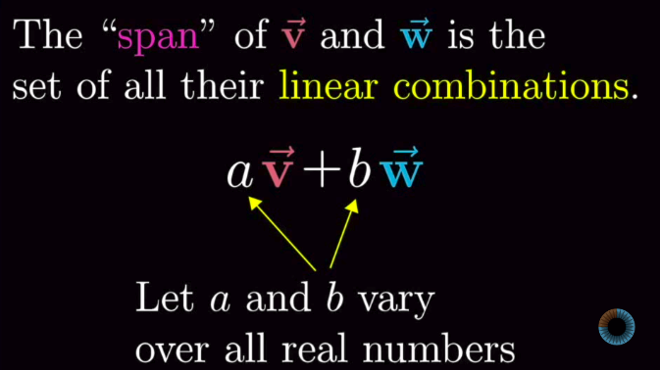
Linear Combinations, Span, Basis vector
Span of a vector is set of all the vectors we can have using the linear combinations of vectors.
A vector can reach out to all the points in space
Other Possibilities:
Can be Zero if both vector are zero
Can be just a line if one vector happened to be a linear combination of the other.

Slide 10
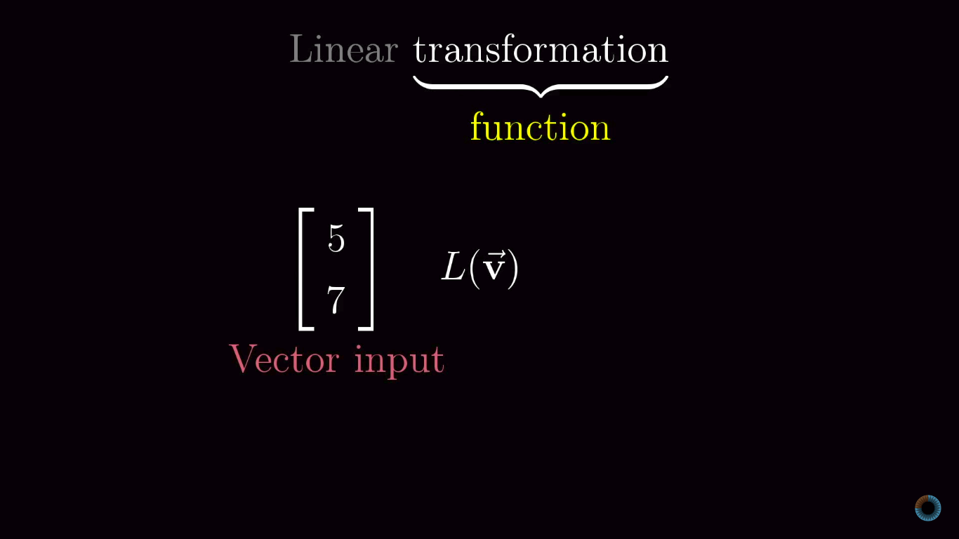
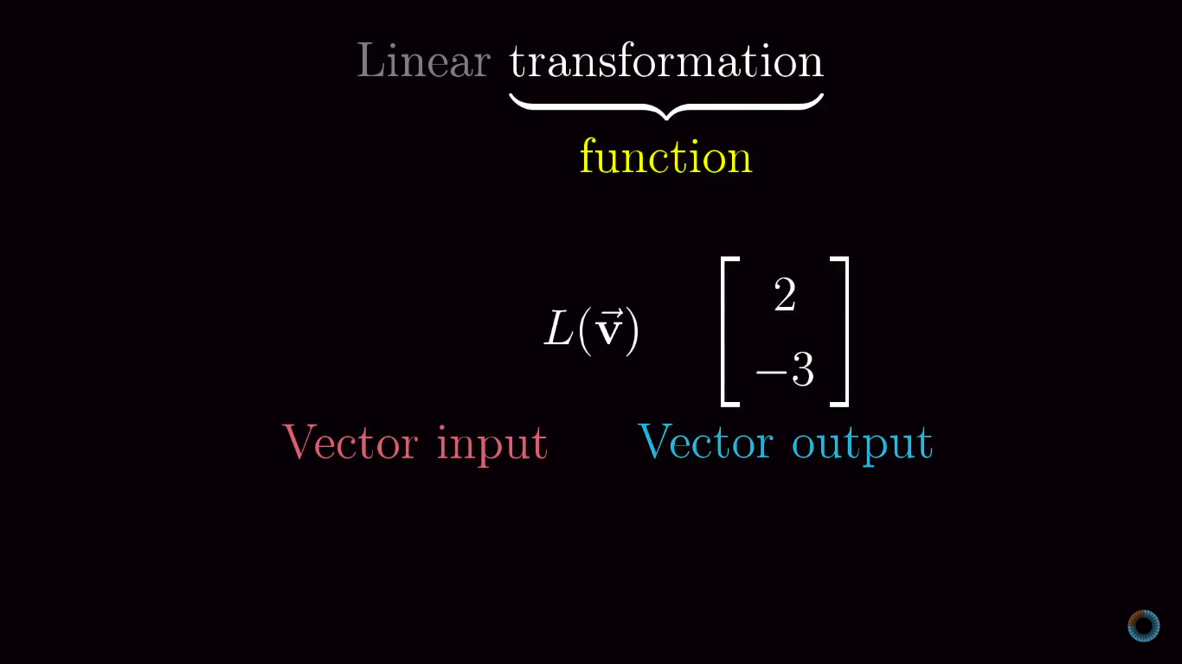
Linear Transformations
Transformation is essentially a fancy word for “function”
It takes something as input and spits out an output
Specifically in linear algebra case, we like to think of it takes a vector in and spits out a another transformed vector.
Examples of Linear Transformations are 90 deg Rotation, Shear.

Slide 11
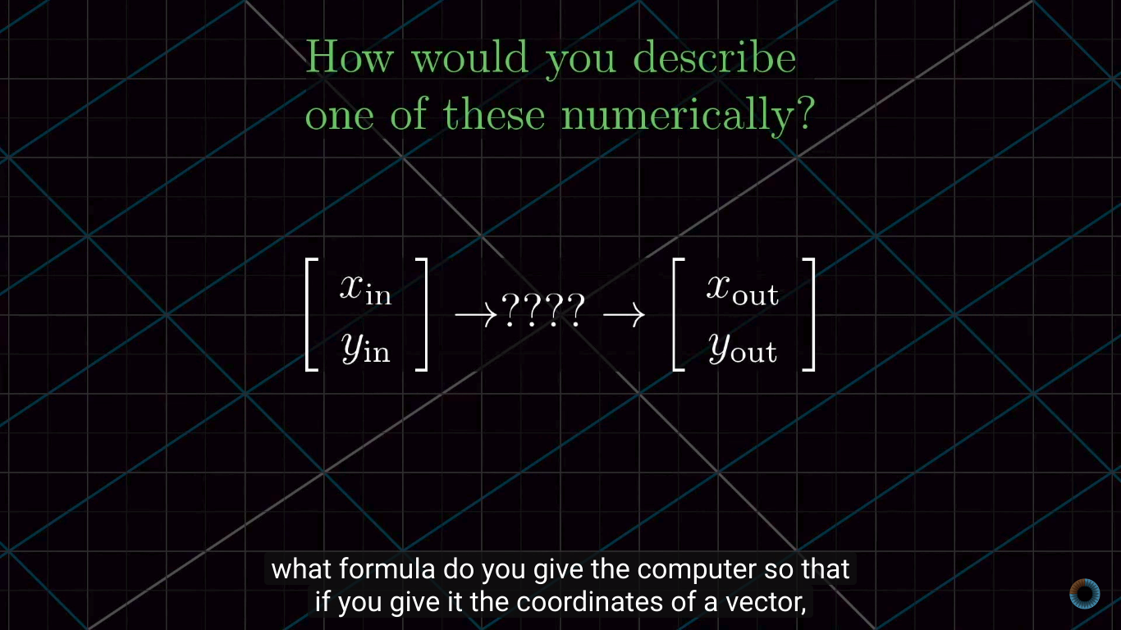
Linear Transformations
But What does that word linear mean?
Even after the transformation is done, some features should be not changed:
All lines must remain lines not as curves or any other
Origin should be fixed.
How do we numerically denote Linear transformations?

Slide 12
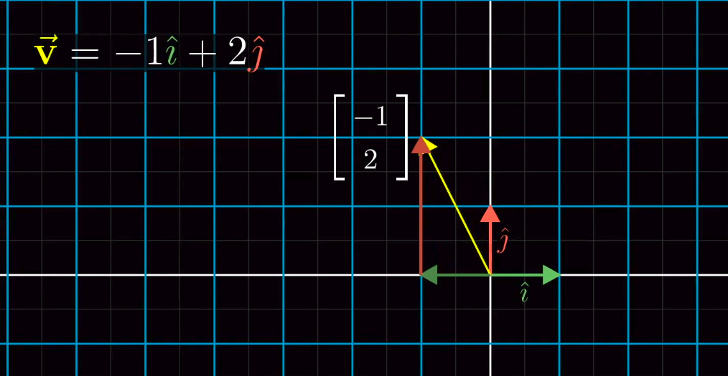
Linear Transformations
For example: Consider a vector with coordinates (-1,2) which is -1 times i-hat , 2 times j-hat.
Now apply some linear transformations with it, and we follow all three vectors.
The Place where V vector lands will be -1 times where i-hat lands, and 2 times where j-hat lands after the transformations is applied.

Slide 13
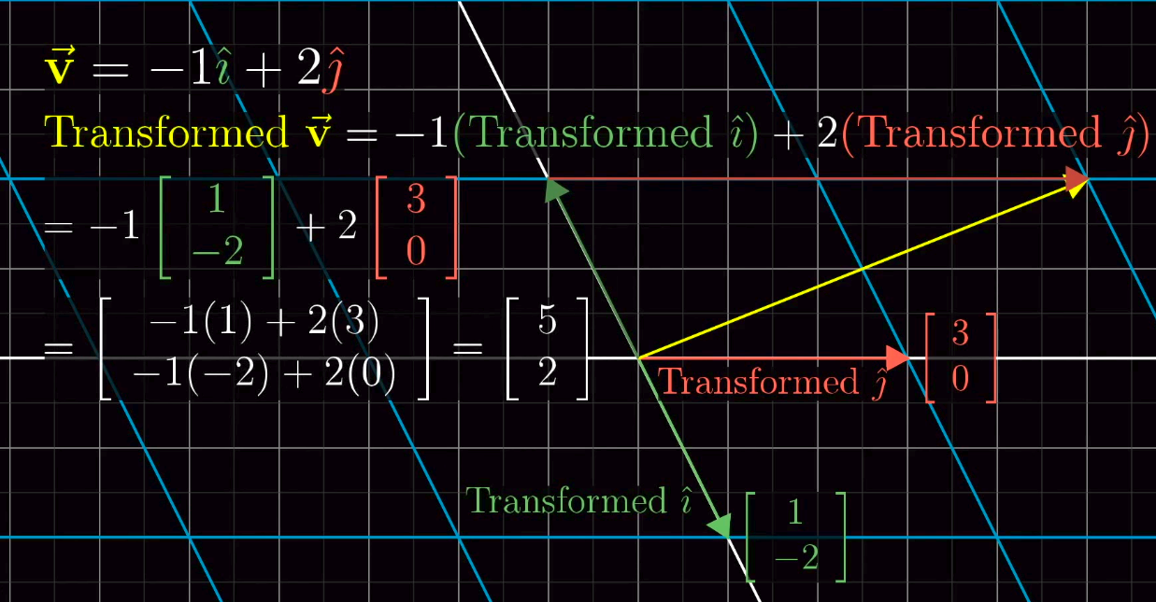
Linear Transformations

Slide 14
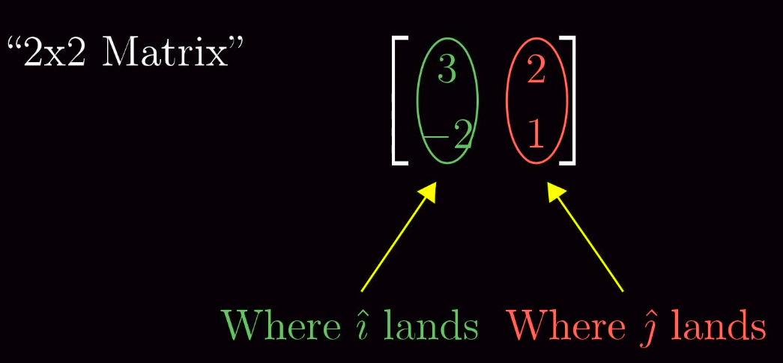
Linear Transformations
Let us record the coordinates of i-hat and j-hat after the transformation applied, in a 2x2 matrix.
Now let us do a matrix vector multiplication.

Slide 15
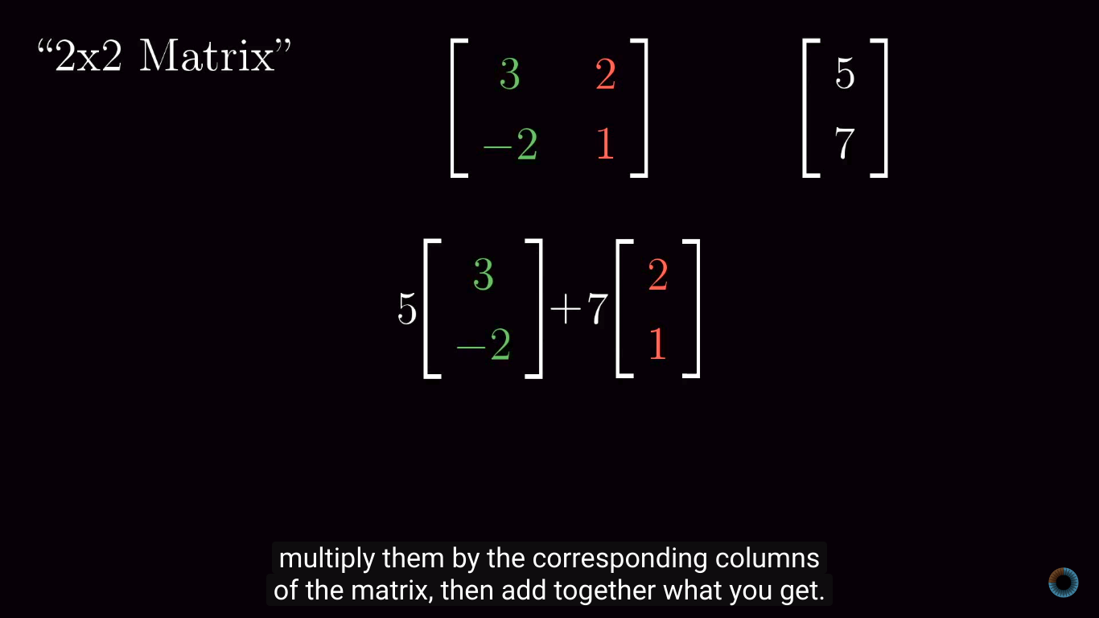
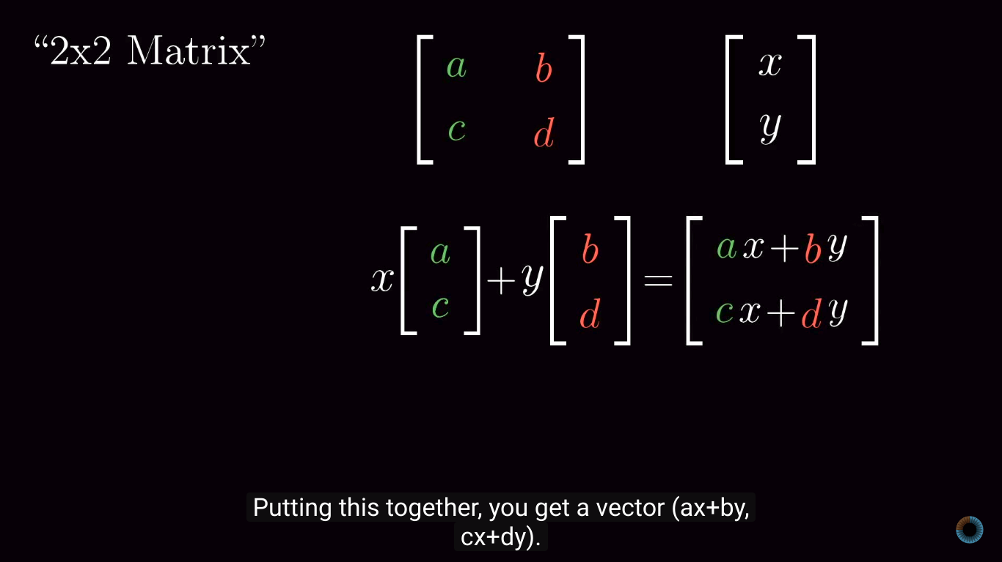
Linear Transformations

Slide 16
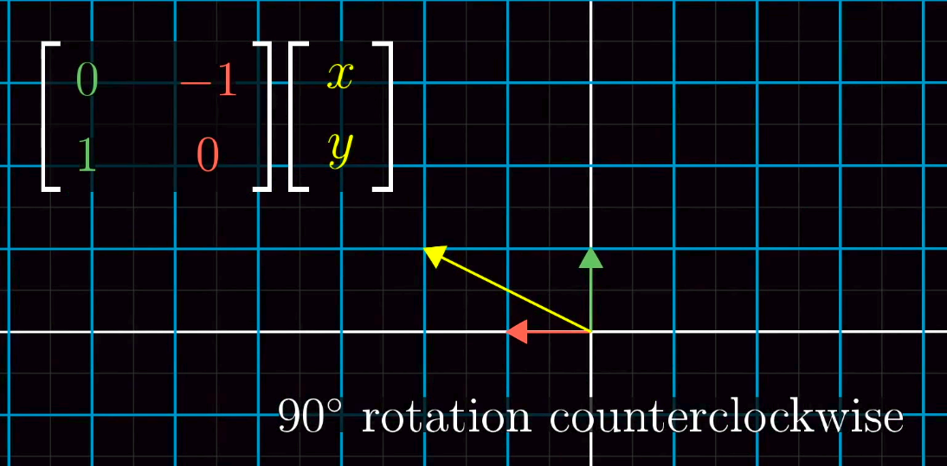
Linear Transformations
Now let us try imagine for 90 deg rotation and shear.

Slide 17
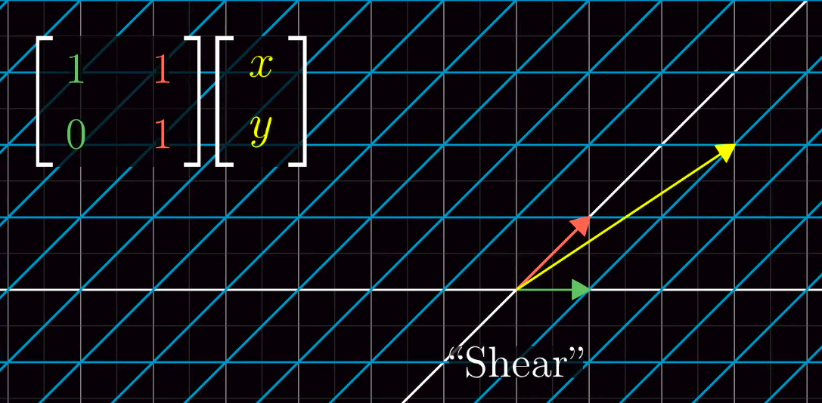
Linear Transformations

Slide 18
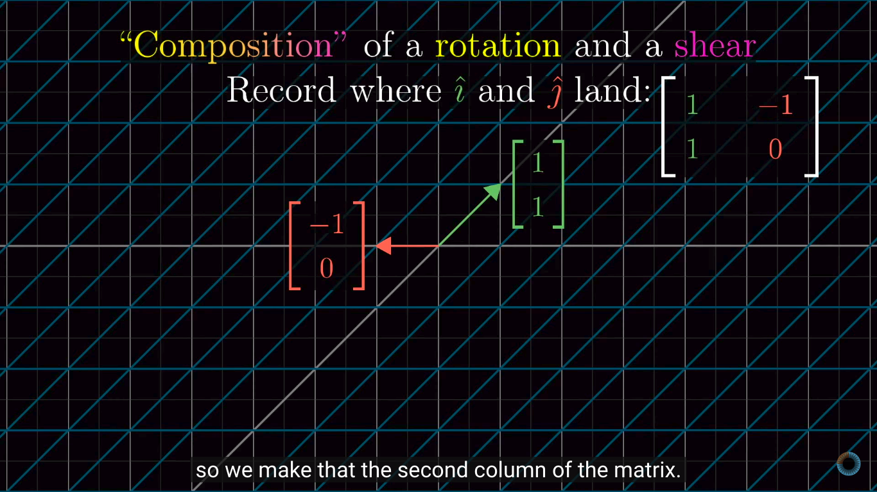
Matrix Multiplication as Composition
Multiple transformations is called Composition.
Example is combining rotation and shear transformations together.
It is too simple, just record where i-hat, j-hat lands after applying both the transformations.

Slide 19
Matrix Multiplication as Composition
Here the order matters, if you try doing Shear first and then do a 90 deg rotation, it gives a different transformation compared to the previous.
So it proves that, M₁M₂ is not equal to M₂M₁
One more rule to remember is Associativity.
A(BC) = (AB)C

Slide 20
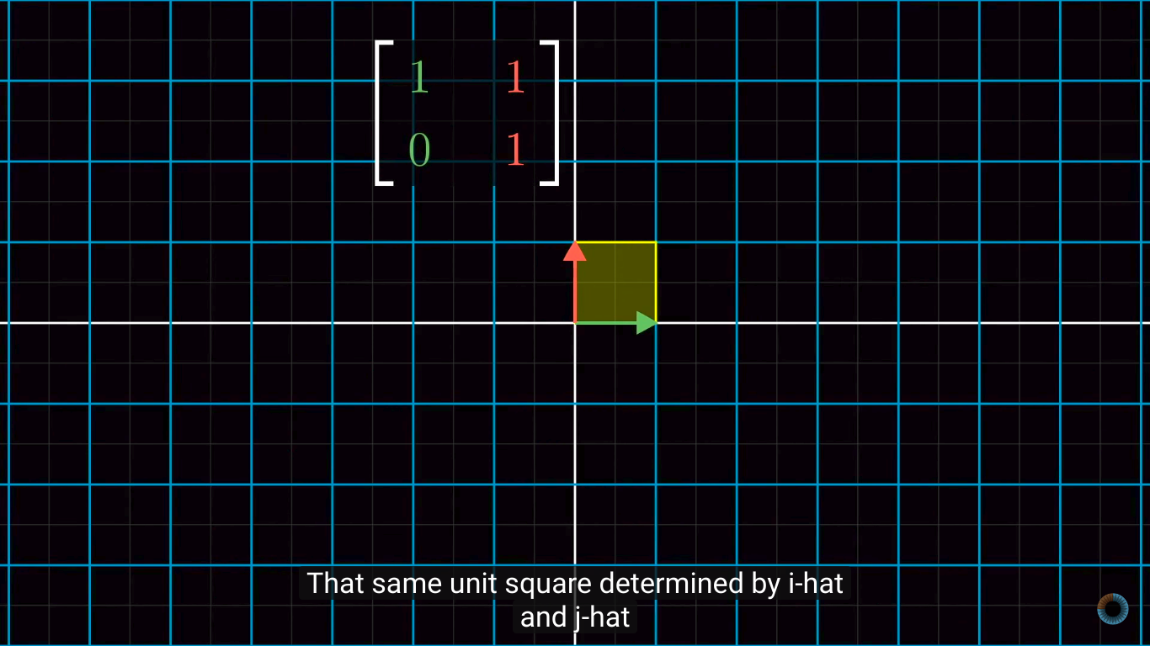
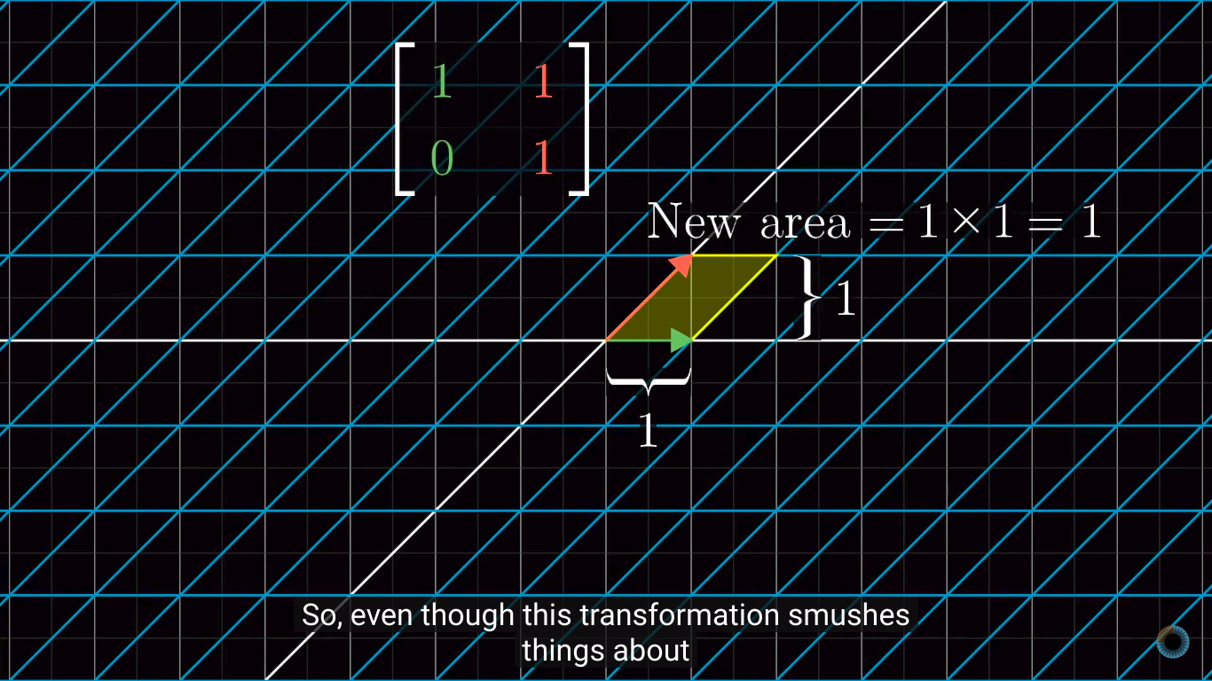
Determinants
The Fact that the linear transformations changes any area is called determinant of linear transformations.
Let us imagine a unit vector i-hat, j-hat which forms a area of 1, which still remains as 1 when we apply shear transformation on it.

Slide 21
Determinants
So even though transformations, smushes things about, it seems to leave area unchanged, at least in the case of 1 unit square.
Actually if we know how the area of that one unit square changes, it can tell us how any possible region in space changes.
By arbitrarily doing a approximation of single unit square even for non even grid spaces.
This is the fact saying determinant is a factor that scales out the area.
In case of 3 dimension, it is Volume.

Slide 22
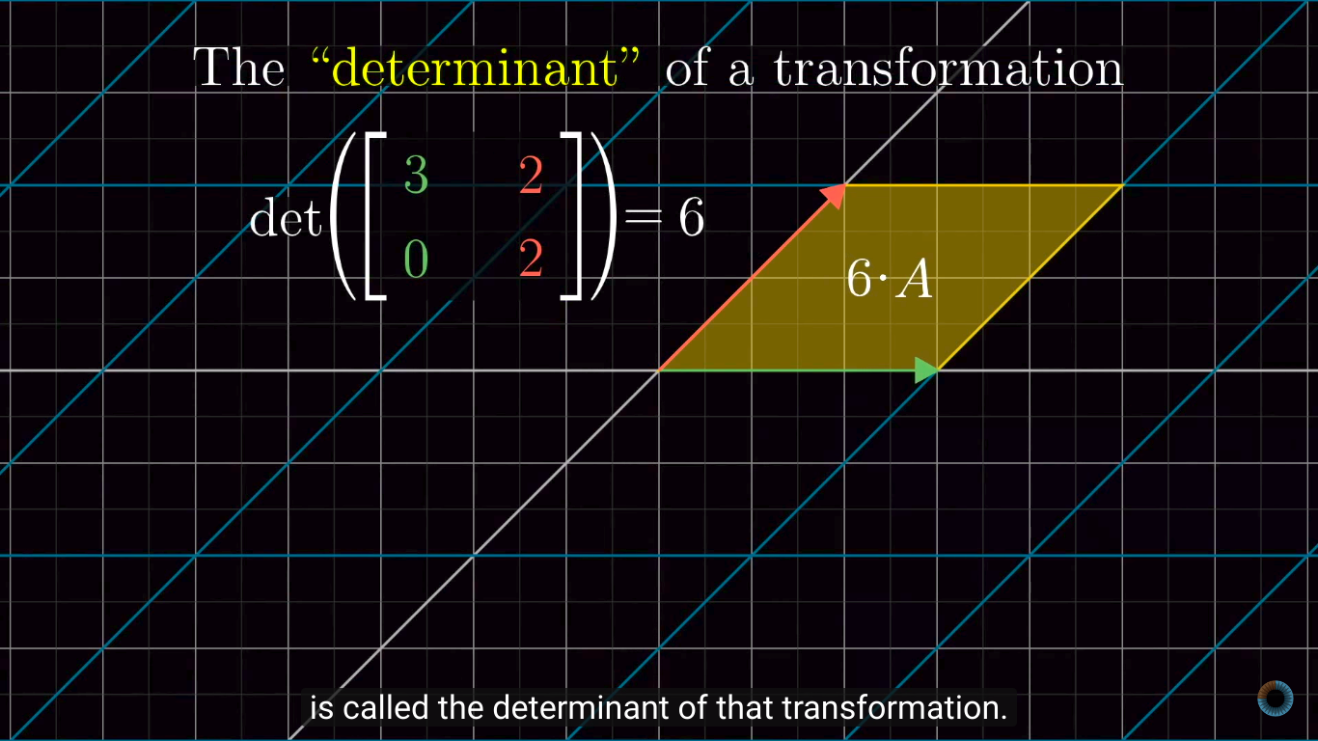
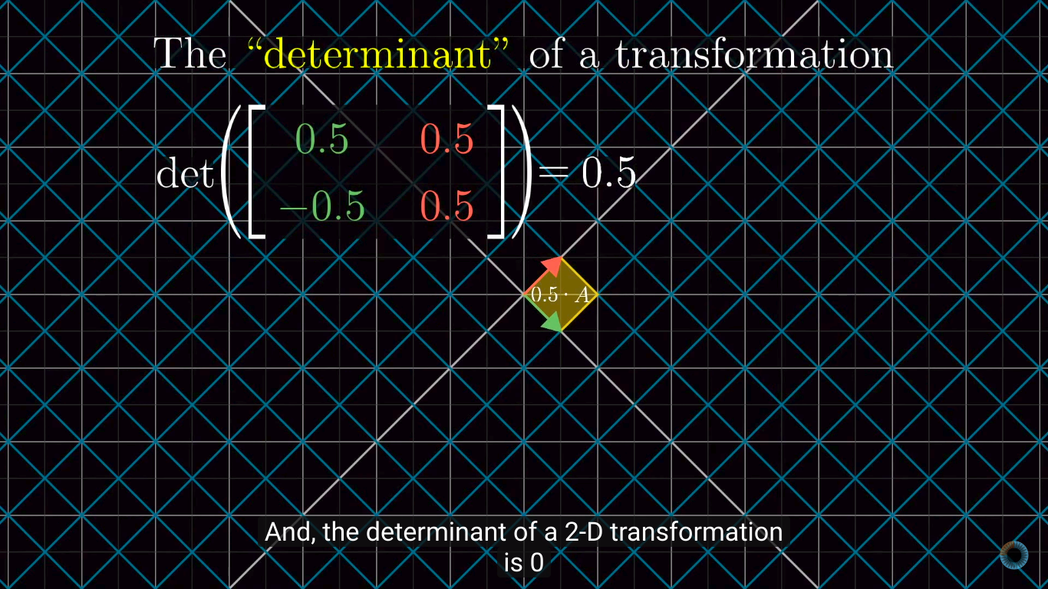
Determinants
Squishes the Area
Stretches the Area

Slide 23
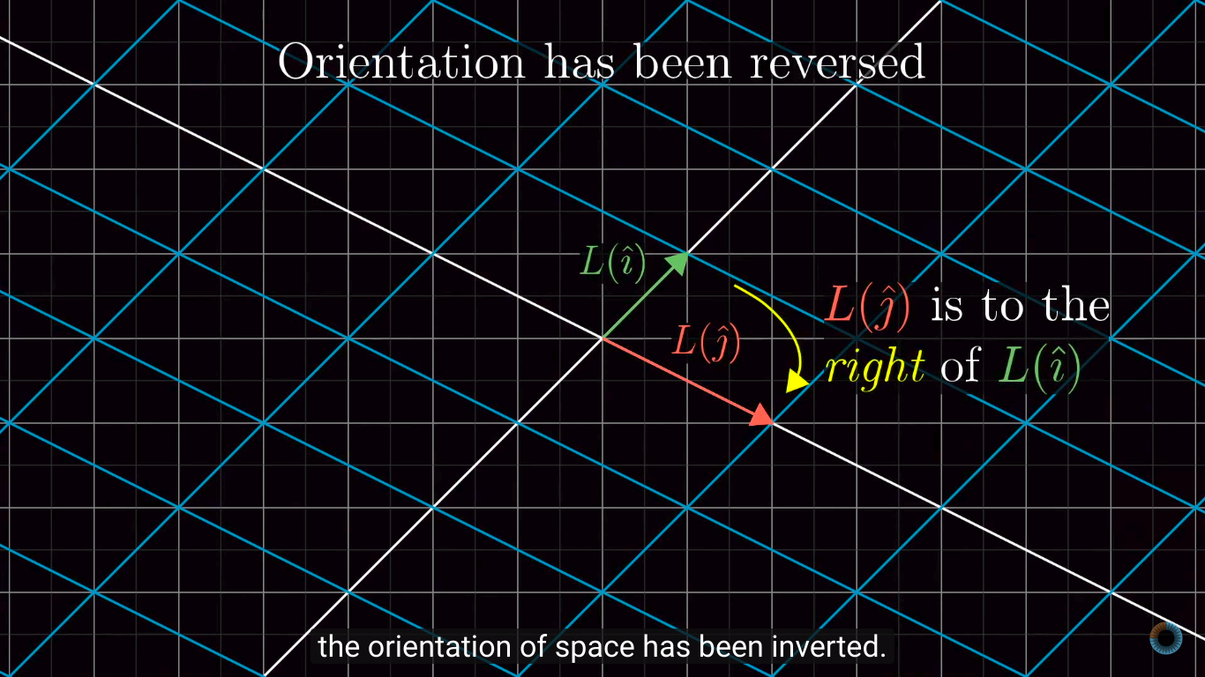
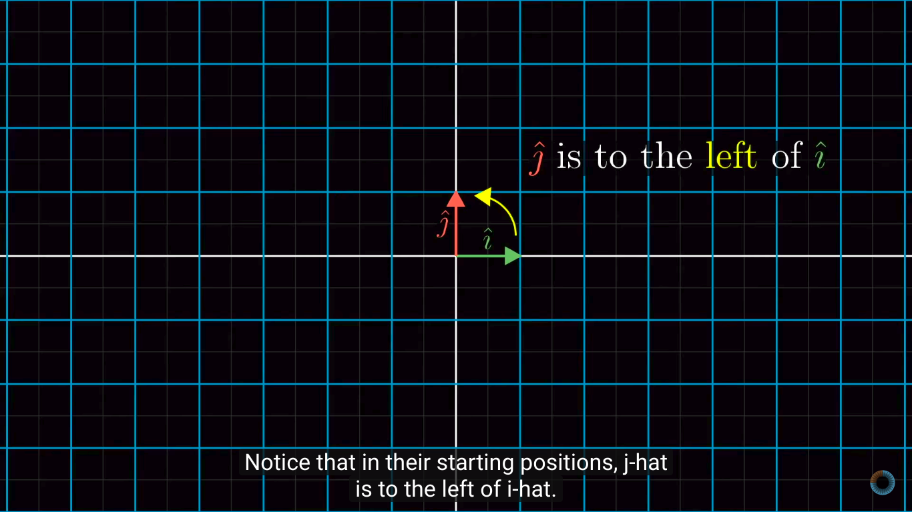
Determinants
Determinant can also be Negative, based on the position of j-hat with respect to i-hat after the transformation.
+ve - when j-hat is left to the i-hat
-ve - when j-hat is right to the i-hat
Determinant can also be zero, if the transformation squishes all the space into a line or point.

Slide 24
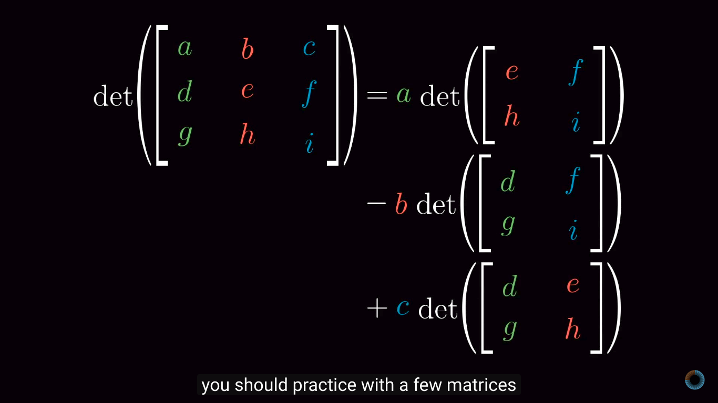
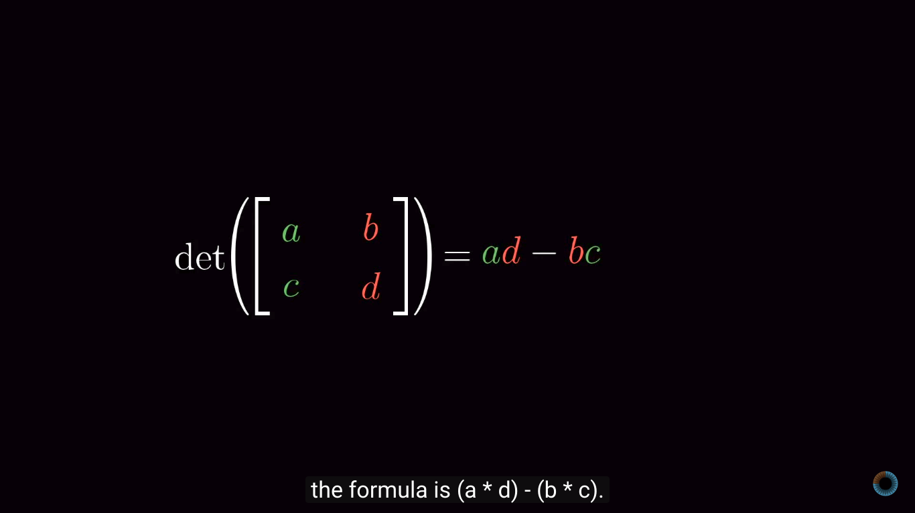
Determinants
Determinants are calculated by using these well known formulas.
But what is the intuition behind this?

Slide 25
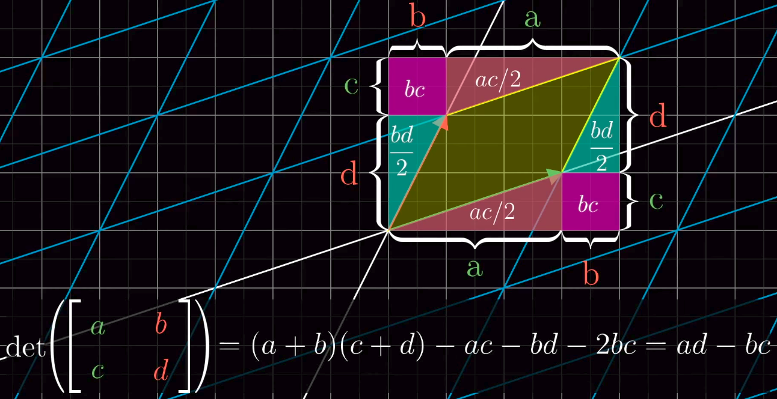
Determinants

Slide 26
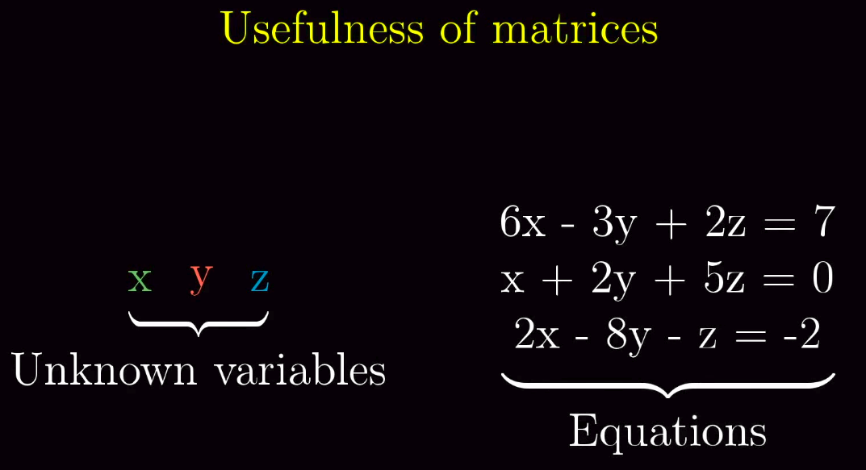
Inverse of matrix
Inverse of matrix can be computed by Gaussian Elimination, and Row Echelon Form. But we are not going to discuss that here.
In Spite we will see intuition and geometric way of understanding the inverse.
Usefulness of matrices is solving the linear system of equations.

Slide 27
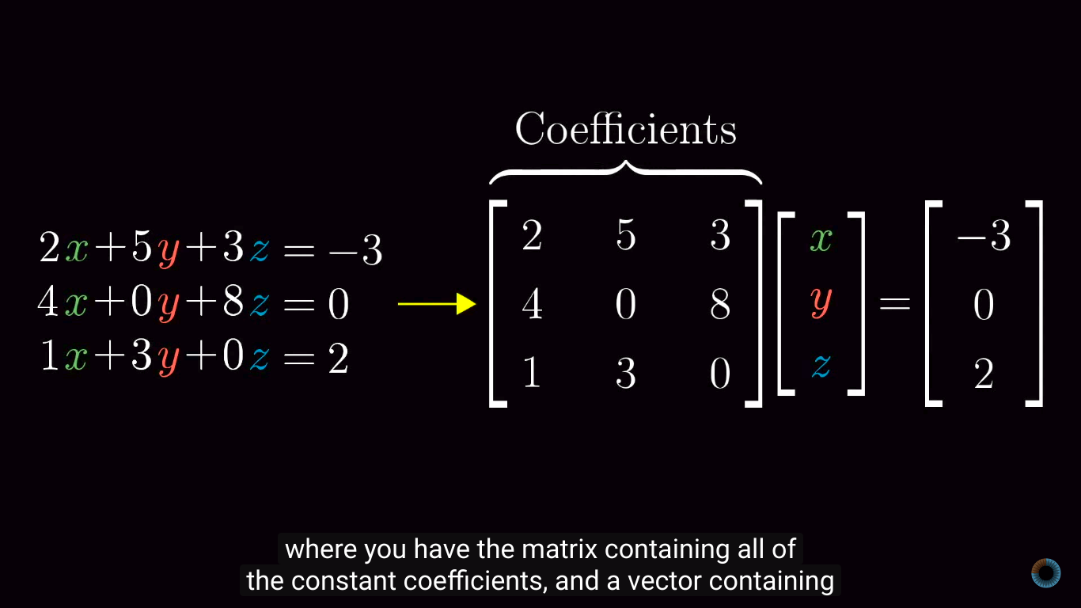
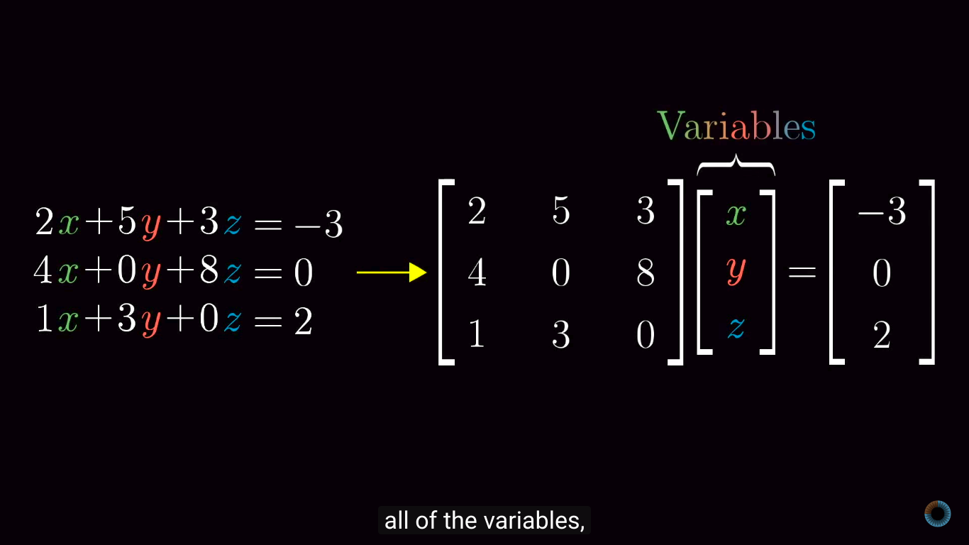
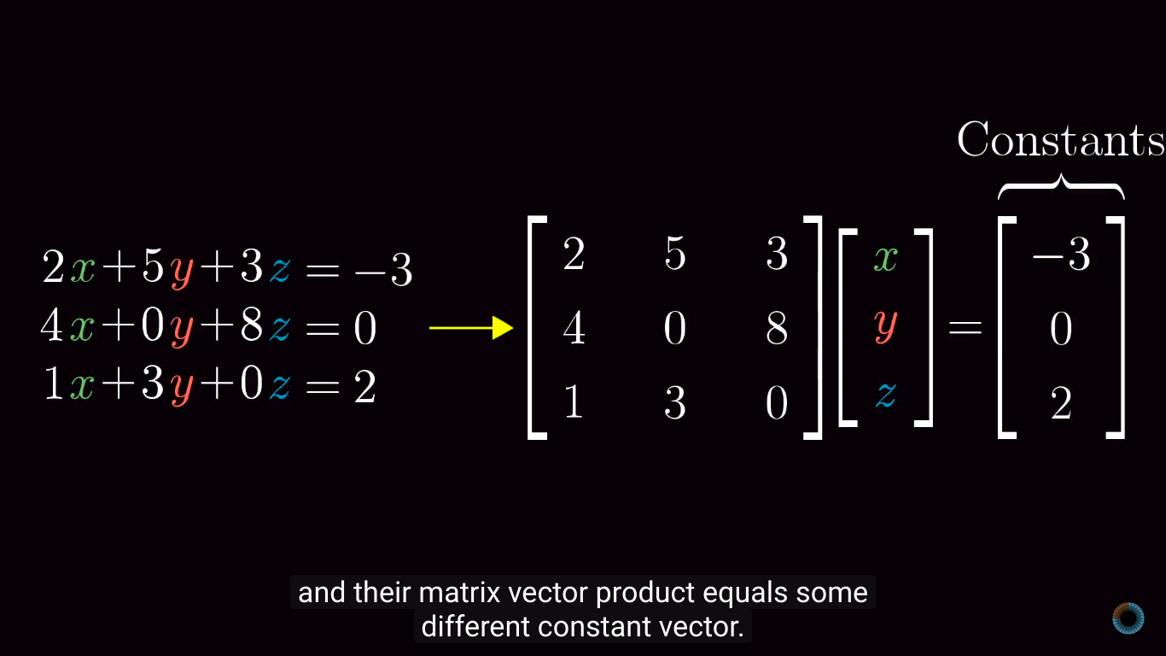
Inverse of matrix

Slide 28
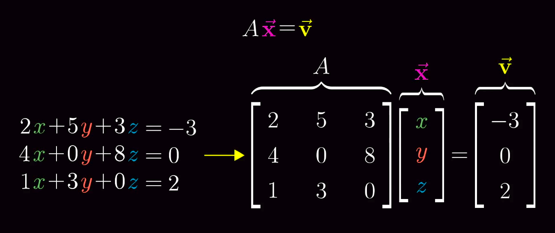
Inverse of matrix

Slide 29
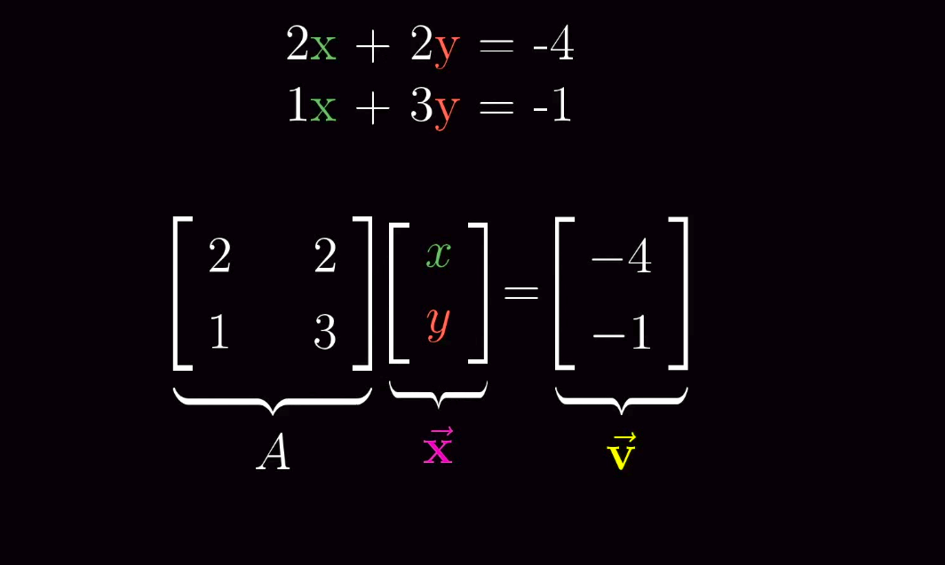
Inverse of matrix
AX=V means we are looking for vector X which after applying transformation A lands on V.
Example:

Slide 30
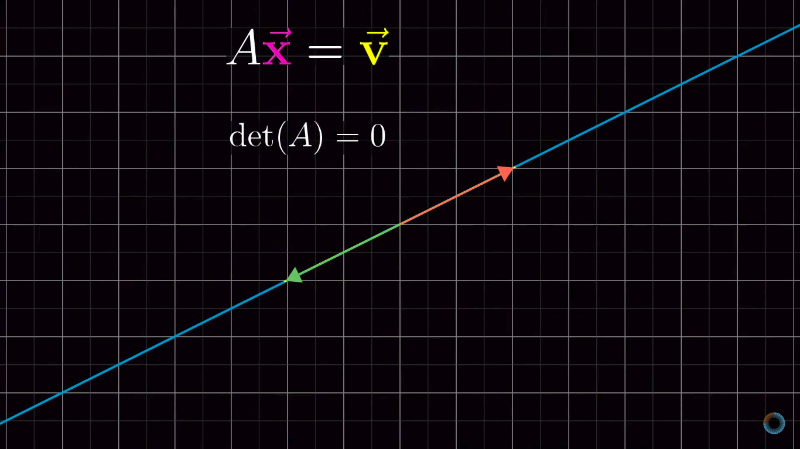
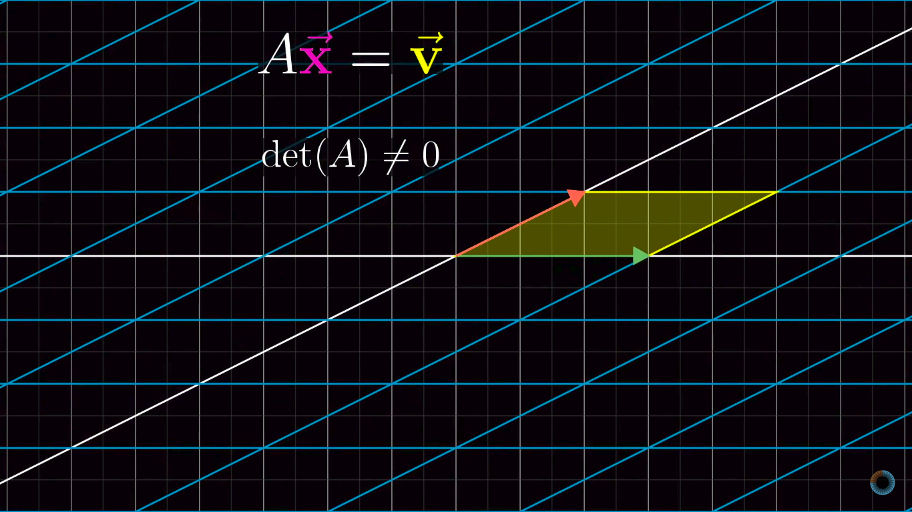
Inverse of matrix
The solution to this depends on whether the transformation associated with A squishes or stretches the all of the space to a lower dimension like a line or point.
Else leaving it in a 2 dimension space. In the language of determinants, whether it is zero or not.

Slide 31
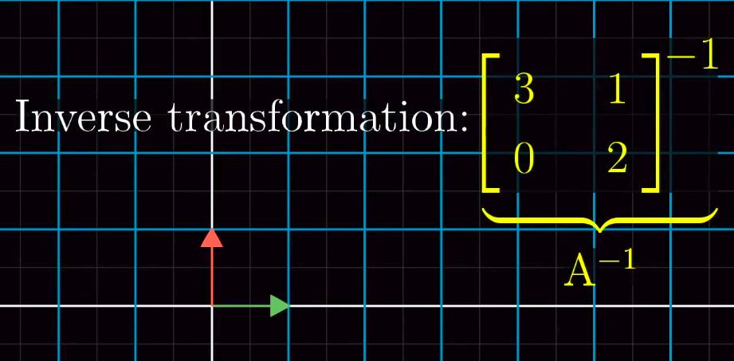
Inverse of matrix
When we play the transformation in reverse, it actually corresponds to a seperate linear transformation commonly called the inverse of A.
Denoted A to the negative one. A⁻¹

Slide 32
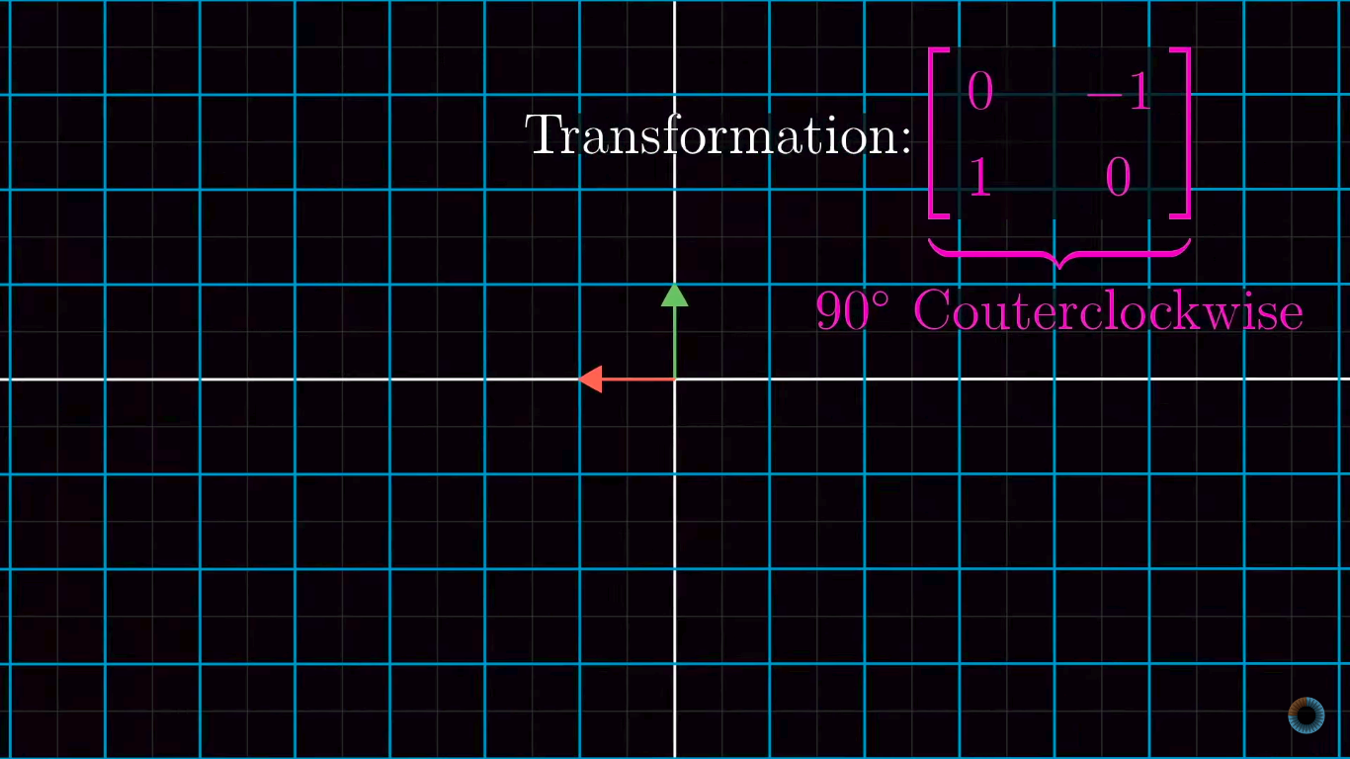
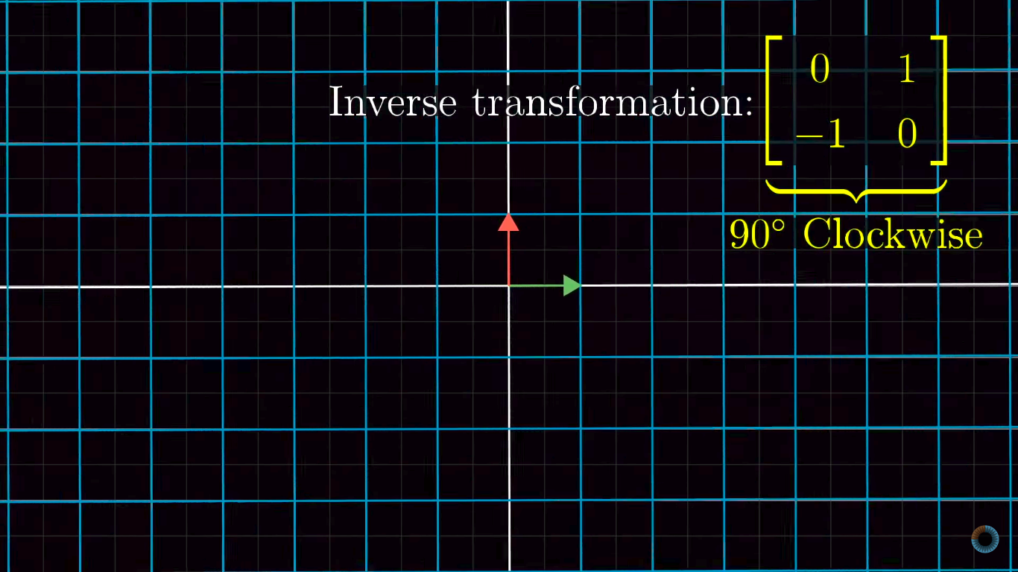
Inverse of matrix
For example, Take the 90 deg rotation transformation.

Slide 33
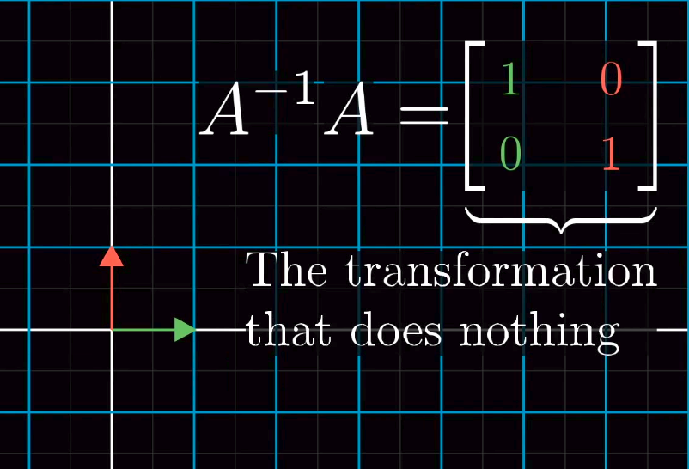
Inverse of matrix
Applying one transformation after another is calculated algebraically, using matrix multiplication.
Multiplying A inverse and A, gives you the transformation matrix, that does no transformation.
This Matrix is called the Identity matrix.
It is still possible to get a solution, when determinant of A is zero, when transformation squishes onto a line, the vector V can live somewhere on that line.

Slide 34
Rank, Column Space, Null Space
The Rank denotes the number of dimensions in the output of transformations.
Rank 1 → 1 dimension
Rank 2 → 2 Dimension
Rank 3 → 3 Dimension
The set of all possible outputs of a transformation of a vector is called “Column Space”.
The column space helps us to understand, whether does the solution exists or not.
More precise definition of Rank can be, the number of dimensions in the column space.
When the dimensions can be high as be, meaning it equals the number of columns, we call it a “Full Rank Matrix”.
Null space is space of all the vectors that land on Zero, this helps us to understand, set of all possible values for the solution.

Slide 35



Academy for Ai
https://www.youtube.com/channel/UC-CFsLoMo8WeoCWGzysC1MQ
https://www.facebook.com/academyforai
https://twitter.com/academyforai

Slide 36
Thank you!

